Slide 1
Welcome to the HMN Webinar Series!
To ensure the quality of your experience, please:
Use the Audio Set up Wizard (located under Meeting) to ensure that your audio is working properly.
Check to see if your speaker is activated. When activated, the speaker icon at the top of the screen should appear green.
To ask a question/make a comment at any point throughout the webinar, type using the chat room in the bottom of the screen. We’ll address your questions during the discussion portion of the webinar.
Thank you! We will begin shortly!

Slide 2
Crisis Text Line: Opportunities in Research and Practice
HMN Webinar Series
Session #15, December 2015

Slide 3
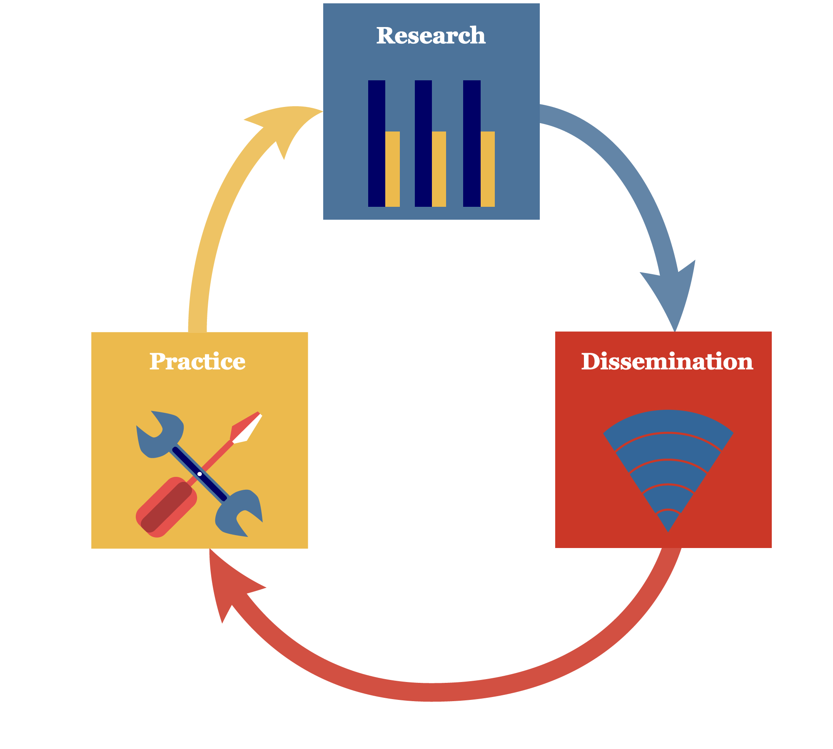
Welcome and About HMN
The Healthy Minds Network
Research-to-practice network based at University of Michigan
Public health approach to mental health among young people
HMN Research-to-Practice Objectives:
(1) produce knowledge (research)
(2) distribute knowledge (dissemination)
(3) use knowledge (practice)

Slide 4
HMN Announcements
HMS community college study
New York Times op-ed, “Hungry, Homeless, and in College”: www.nytimes.com/2015/12/04/opinion/hungry-homeless-and-in-college.html?_r=0 (Sara Goldrick-Rab and Katie Broton)
Working on a second report focusing on mental health measures
Annual College Mental Health Research Symposium (March 8-9, 2016) and Depression on College Campuses Conference (March 9-10, 2016) in Ann Arbor
Opportunity for campuses to join HMS: healthymindsnetwork.org/for-schools/participate

Slide 5
Today’s Webinar
Crisis Text Line: Opportunities in Research and Practice
Presenter: Liz Eddy, Director of Communications and Events, Crisis Text Line
Discussion
Please submit questions at any point throughout the webinar using the chat box!

Slide 9
Notes:
View video: https://www.youtube.com/watch?v=HJaLZGDwYiI&feature=youtu.be

Slide 11
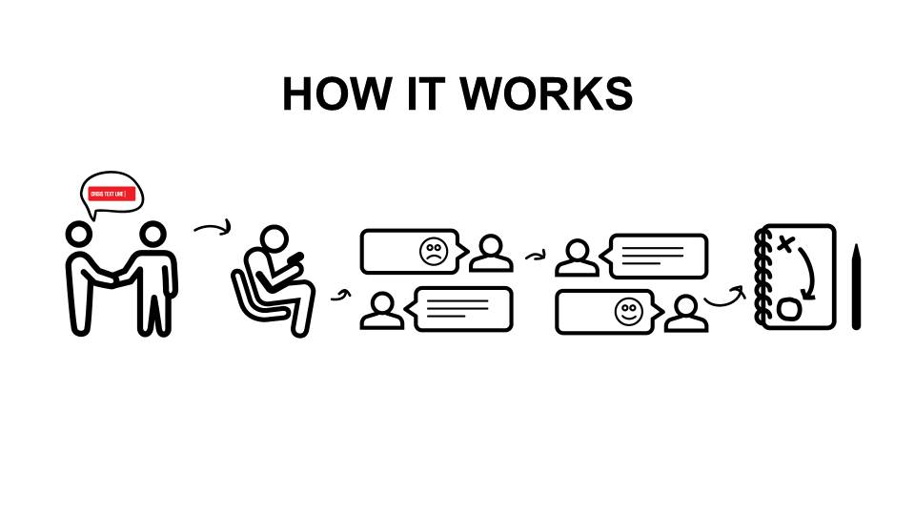

Slide 12
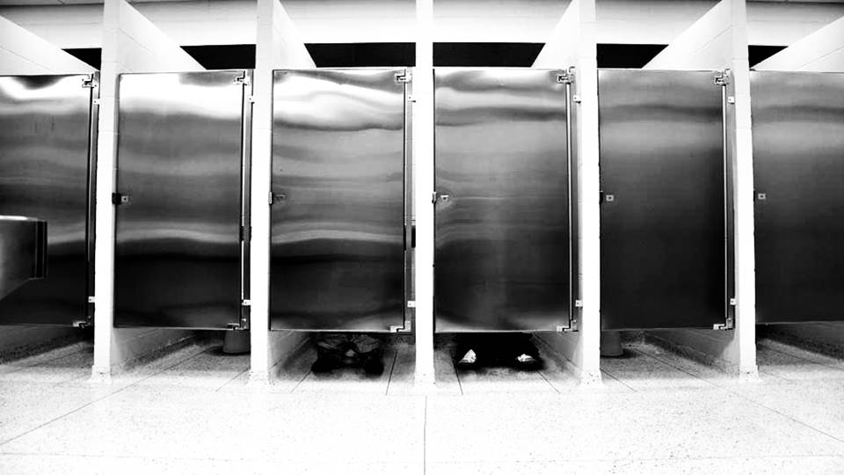

Slide 17
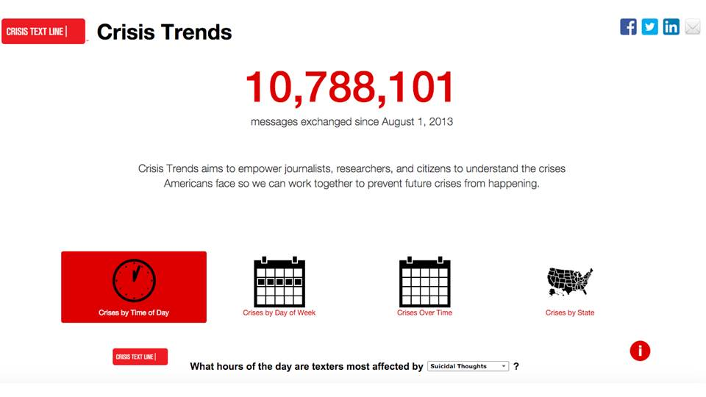

Slide 18
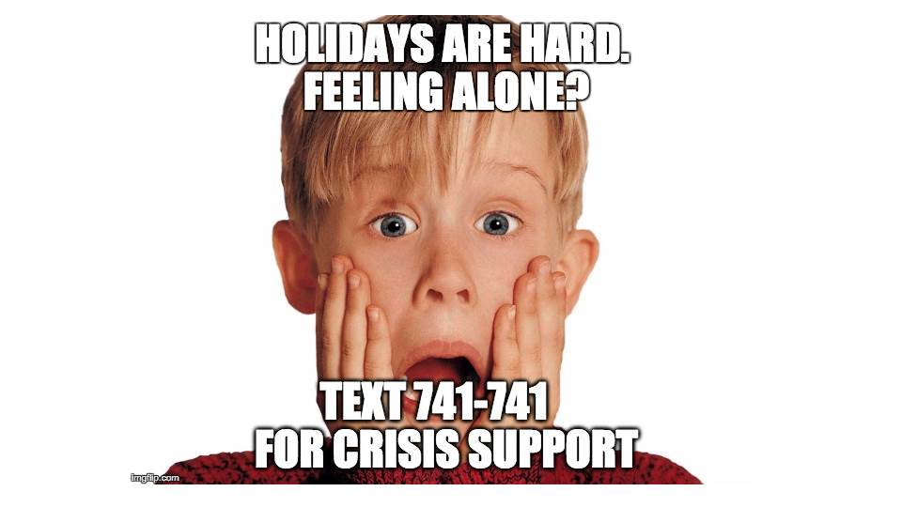

Slide 19
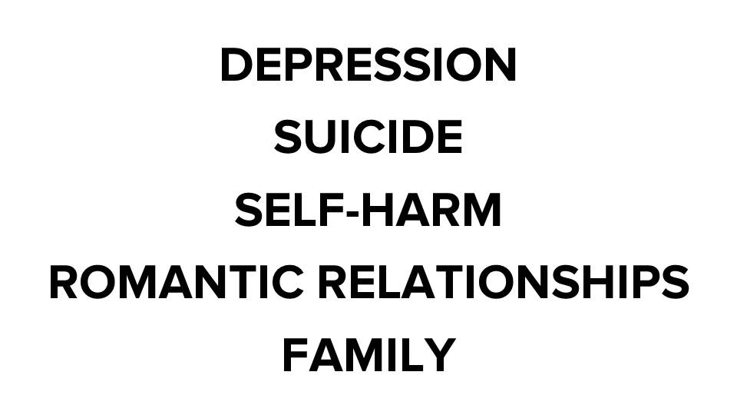

Slide 21
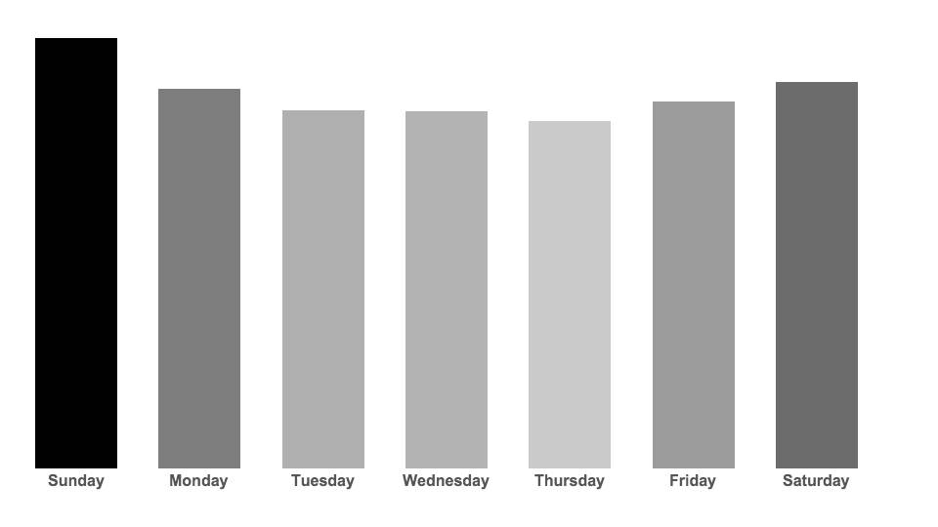

Slide 23
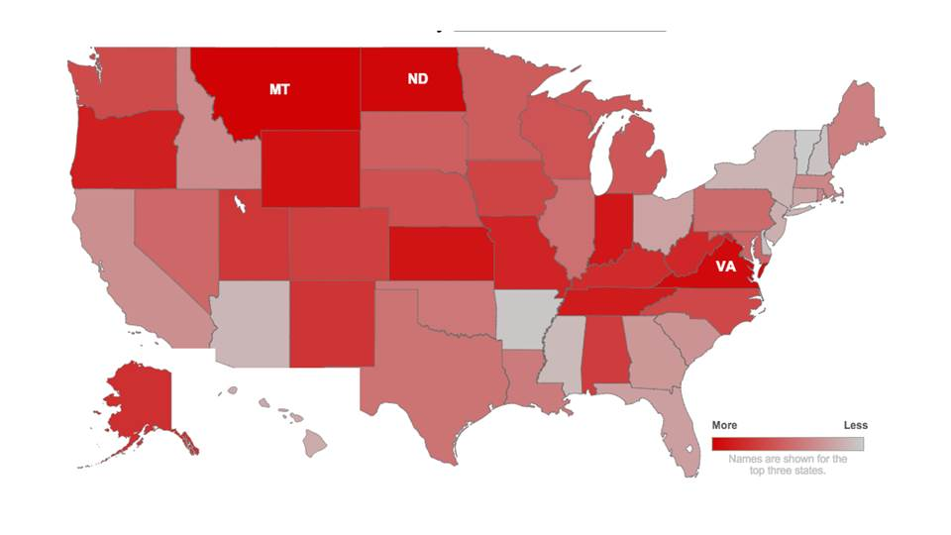

Slide 32
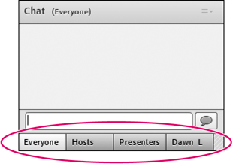
Discussion (Q&A)
To pose a question, please submit your question using the “Chat Room” in the bottom corner of the screen.

Slide 33
More Information
Crisis Text Line
www.crisistextline.org | liz@crisistextline.org
Healthy Minds Network
www.healthymindsnetwork.org | healthyminds@umich.edu

