Slide 1
Welcome to the HMN Webinar Series!
To ensure the quality of your experience, please:
Check to see if your speaker is activated. When activated, the speaker icon at the top of the screen should appear green.
To ask a question/make a comment at any point throughout the webinar, type using the chat room in the bottom of the screen. We’ll address your questions during the discussion portion of the webinar.
Thank you! We will begin shortly!

Slide 2
Effective Presentation of Behavioral Health Tech
The Healthy Minds Network Webinar Series
Session #24, February 2018

Slide 3
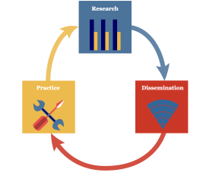
Welcome and About The Healthy Minds Network
The Healthy Minds Network
Research-to-practice network based at University of Michigan
Public health approach to mental health among young people
HMN Research-to-Practice Objectives:
(1) produce knowledge (research)
(2) distribute knowledge (dissemination)
(3) use knowledge (practice)

Slide 4
HMN Announcements
Currently enrolling schools for HMS 2018-19
Email us at healthyminds@umich.edu
Fill out our preliminary interest form
healthymindsnetwork.org/participate/how-to-participate

Slide 5
Today’s Webinar
Health and wellness resource warehouses
Effective “e-health” tools (mobile apps, web-based content) as well as the best ways to disseminate these resources
Presenters
Nathaan Demers, Psy.D.
Carly Thanhouser, MPH

Slide 6
Academic Reporting Tools
ECoach
Problem Roulette
ViewPoint
?
Student Explorer
GradeCraft
MWrite
Healthy Minds Hub

Slide 7
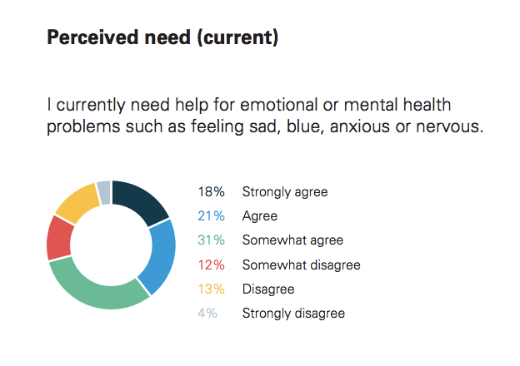
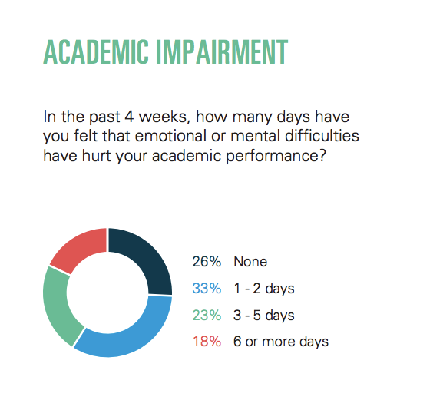
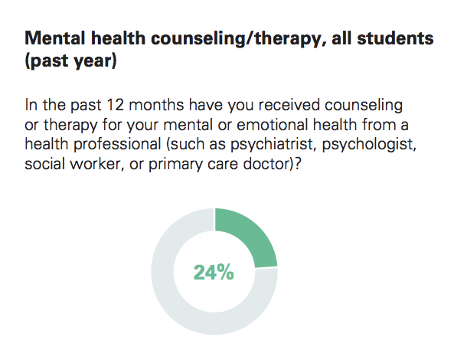
Some Healthy Minds Data

Slide 8
How do we reach students on THOSE DAYS?
ACCESS
“I don’t know where to find any mental health tools.”
DIGITAL
PERCEIVED NEED
“These tools aren’t for someone like me.”
PERSONALIZED
CHOICE OVERLOAD
“I don’t know exactly what I need.”
“I don’t know what actually works.”
EXPERT-CURATED

Slide 9
.
ACCESS: “I don’t know where to find any mental health tools.”
The 5 A’s of access:
Affordability
Availability
Accessibility
Accommodation
Acceptability
Other considerations:
Well-designed tools
Easy-to-use tools
Tools that consider the design needs for all populations
*Digital solution

Slide 10
PERCEIVED NEED: “These tools aren’t for someone like me.”
It’s hard to self identify:
Students think the MH tools are for people worse off than they are
Often don’t seek help from counseling centers until crisis
Only 35% of students with mental health problems are using mental health services and resources (HMS, 2016-2017)
A solution should change perception:
Guiding someone to awareness of MH status
Providing assessments to guide recommendation
Use personalized language to reduce:
Resistance to results
Information regurgitation
*Personalized feedback

Slide 11
How do we personalize in a digital space?
Targeting
Simple tailoring
Expert-derived recommendations
Complex computer-generated tailoring

Slide 12
CHOICE OVERLOAD: “I don’t know what I need or what works.”
There’s no easy way to navigate this space when you aren’t sure:
The digital mental health resource space is saturated
Google search? App store search?
How do you know what to look for?
How do you know what works?
A solution should guide someone towards informed choices:
Something we believe is a sound, evidence-based option
Can narrow choices based on what we know works, industry practices
*Expert-curated suggestions
Notes:
Think about the app store: few apps are marketing themselves as “Great for people with depression.” Because then no one is going to use it. They’re all marketed as wellness apps.
I tried to quantify how many wellness and mental health apps are in the app store and i actually couldnt because it’s literally not possible to count.
If someone finds an app that looks interesting, the only measure of it “working” is the reviews on the app store. Or maybe things they’ve found with a google search.

Slide 13
Personalized, expert-curated, digital solutions
We need to know who they are and what they need:
Approachable surveys about attitudes, behaviors, feelings
Screeners like PHQ9 or PHQ4
We need to give them what works for them:
Tailored communications about status
Suggested tools and resources based on needs
Plain language and motivational interview principles
Normative and informative feedback

Slide 14
Digital
Personalized
Expert-curated

Slide 15
YOU at College // Research
College counseling utilization rates increased at a rate 5x that of college enrollment from 2009-2015 ¹
50% of students who leave for mental health reasons have not used campus supports²
Suicide is the 2nd leading cause of death on college campuses.³

Slide 16
YOU at College // Student Focus Groups
Comprehensive Student Experience
A Successful Online Well-being Platform
Upstream Approach
Engaging UX/UI
Confidential / Anonymous
Personalized

Slide 17
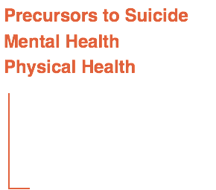
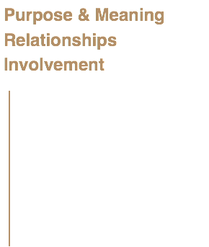
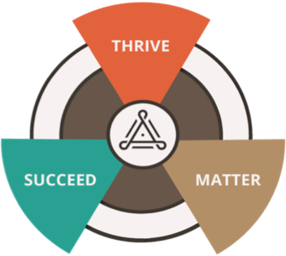
YOU Well-being Model

Slide 18
Campus Partners // National Data Set

Slide 19
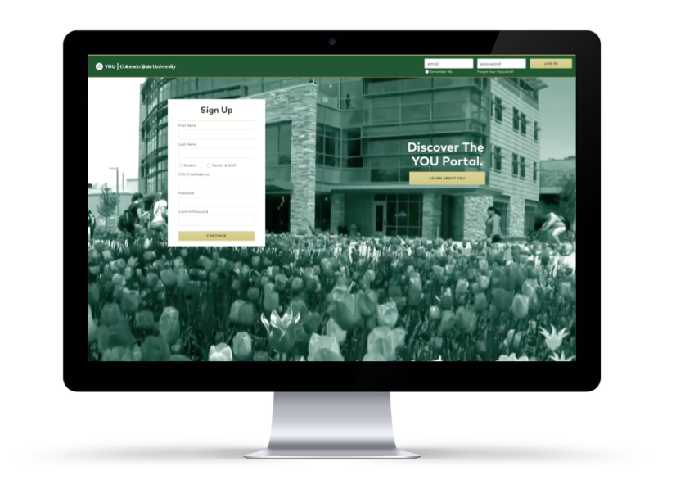
The Portal // YOU@CSU

Slide 20
Data Usage
• 35,000+ Unique Sessions
• 24,000+ unique visitors
• 250,000+ Page Views
• 9,000+ Reality Checks Taken
• 5:00+ minutes average time on site
• 1,500 prior to stepping foot on
campus

Slide 21
References
¹ Center for Collegiate Mental Health. (2016). 2015 Annual Report http://ccmh.psu.edu/wp-content/uploads/sites 3058/2016/01/2015_CCMH_Report_1-18-2015.pdf
² National Alliance on Mental Illness (2012). College Students Speak. https://www.nami.org/getattachment/About-NAMI/Publications-Reports/Survey-Reports/College-Students-Speak_A-Survey-Report-on-Mental-Health-NAMI-2012.pdf
³ Sabatke, Sarah. (2016) Mental health on college campuses: A look at the numbers. USA Today College. http://college.usatoday.com/2016/01/30/mental-health-by-the-numbers/

Slide 22
Thank You! Today’s webinar slides will be available on the HMN website: www.healthymindsnetwork.org/events/webinar-series
Nathaan Demers, Psy.D.: nathaan@gritdigitalhealth.com
Carly Thanhouser, MPH: cthan@umich.edu
Healthy Minds Network:
www.healthymindsnetwork.org | healthyminds@umich.edu

