Slide 1
Welcome to the HMN Webinar Series!
To ensure the quality of your experience, please:
Use the Audio Set up Wizard (located under Meeting) to ensure that your audio is working properly.
Check to see if your speaker is activated. When activated, the speaker icon at the top of the screen should appear green.
To ask a question or make a comment at any time, type in the “chat room.” We’ll address questions and comments during the discussion at the end.
Thank you! We will begin shortly!

Slide 2
Developing a Successful Research Agenda in the Field of Adolescent and Young Adult Mental Health
The Healthy Minds Network Webinar Series
Session #9, August 2014

Slide 3
Today’s Webinar
Welcome and about the Healthy Minds Network (HMN)
Reflections from senior researchers
Discussion (Please submit questions at any point throughout the webinar!)

Slide 4
Today’s Presenters
Daniel Eisenberg, PhD
Director, Healthy Minds Network
Associate Professor, University of Michigan School of Public Health
Megan Jones, PsyD
Vice President, Research and Programs, ThriveOn
Jacqueline Pistorello, PhD
Licensed Clinical Psychologist/Research Faculty
Counseling Services, University of Nevada, Reno
Amelia Arria, PhD
Director, Center on Young Adult Health and Development
Associate Professor, University of Maryland School of Public Health

Slide 5
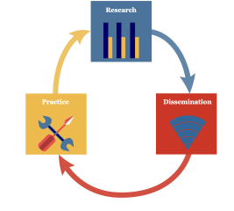
Welcome and About the Healthy Minds Network
The Healthy Minds Network
Research-to-practice network based at University of Michigan
Public health approach to mental health among young people
HMN Research-to-Practice Objectives:
(1) produce knowledge (research)
(2) distribute knowledge (dissemination)
(3) use knowledge (practice)

Slide 6
Reflections from Senior Researchers
(1) How and why did you end up doing research on youth mental health?
(2) What are some of the most important research questions and topics in this area in the coming years?
(3) Do you have any advice for early career scholars?

Slide 7
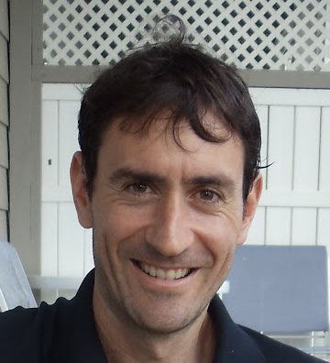
Daniel Eisenberg
Director, Healthy Minds Network
Associate Professor, University of Michigan School of Public Health
daneis@umich.edu

Slide 8
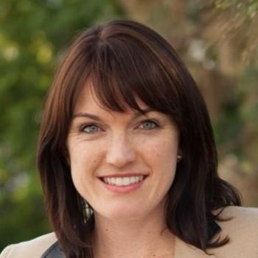
Megan Jones
Vice President, Research and Programs, ThriveOn
megan@thriveon.com

Slide 9
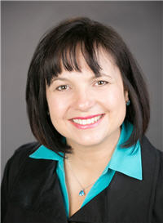
Jacqueline Pistorello
Licensed Clinical Psychologist
Research Faculty
Counseling Services, University of Nevada, Reno
jacqueline.pistorello@gmail.com

Slide 10
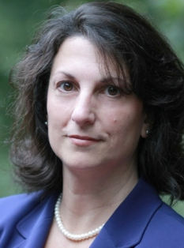
Amelia Arria
Director, Center on Young Adult Health and Development
Associate Professor, University of Maryland School of Public Health
aarria@umd.edu

Slide 11
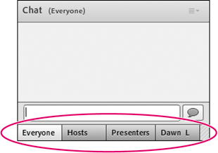
Interactive Discussion
Please submit questions using the “Chat Room” in the bottom corner of the screen.

Slide 12
Contact Information
HMN Team: healthyminds@umich.edu
Web: healthymindsnetwork.org

