Slide 1

Mental Health & Wellbeing during COVID-19: Data from the Healthy minds Study
Sasha Zhou, PhD, MHSA
she/her
Wayne State University, Department of Public Health
The Healthy Minds Network

Slide 3
COVID-19 & College Mental Health
NEW Covid-19 Module: Developed in collaboration with the American College Health Association
Piloted in March-May (Spring) 2020: 18,764 students on 14 campuses
  Combined sample of HMS with ACHA national survey, the National College Health Assessment (NCHA)
September-December (Fall) 2020: 15,966 students on 29 campuses responded to COVID Module
Pre-COVID September-December (Fall) 2019: 33,372 students on 32 campuses

Slide 5
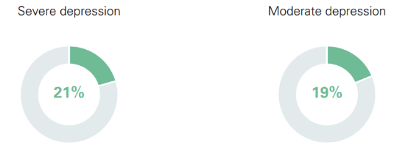
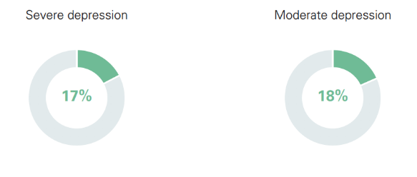
Depression
Fall 2020
Fall 2019
Increase in Depression

Slide 6
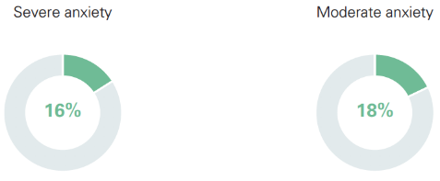
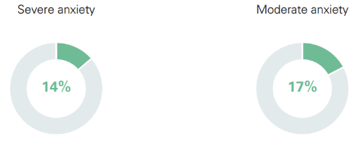
Anxiety
Fall 2020
Fall 2019
Increase in Anxiety

Slide 9
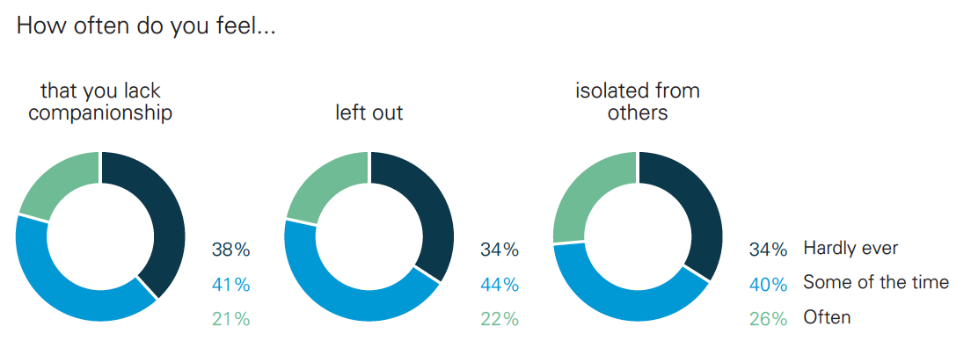
Loneliness: Fall 2020

Slide 10
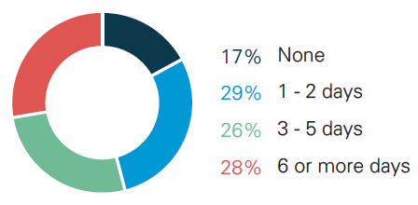
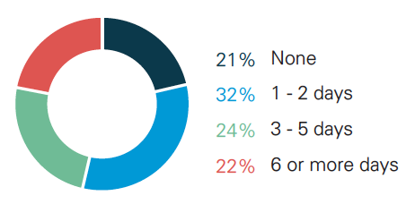
Academic Impairment Due to Mental Health Concerns (Past 4 weeks)
Fall 2020
Fall 2019
83%
Reported at least 1 day of academic impairment due to MH
Increase
78%
Reported at least 1 day of academic impairment due to MH

Slide 17
Birds Eye View
Mental health symptoms continues to impact students across all groups
In this ongoing pandemic students report low sense of belonging compared with previous semesters
Treatment rates among students with symptoms remain low, particularly for students of color
Access to mental health services continues to be a challenge, particularly for gender minority students
This summer, more data will be shared regarding COVID-19 and the impact on students. This will be the first year of a full academic-year of COVID-19 data.

Slide 18

https://healthymindsnetwork.org/
healthyminds@umich.edu
Thank you for joining us today!

